Slide 1
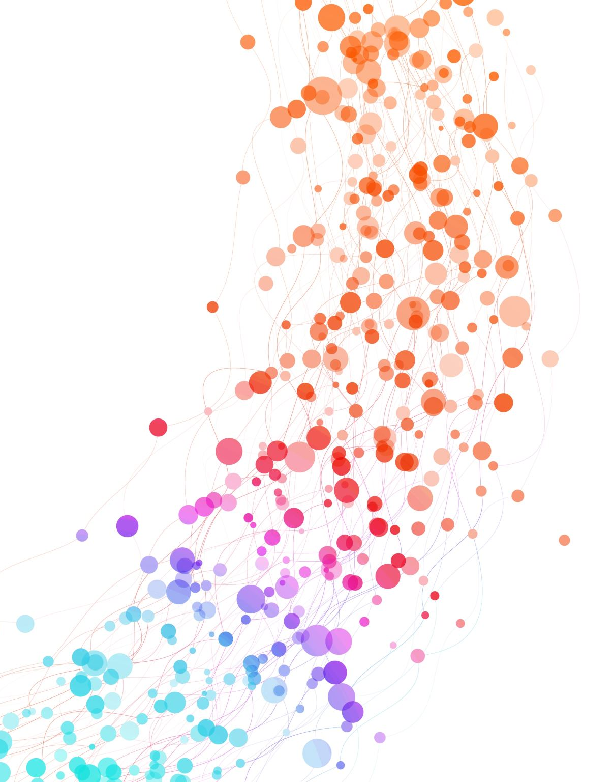
G2M CASE STUDY

Slide 2
In this study, analyses were conducted to support XYZ, a U.S.-based firm, in their plans to invest in the taxi sector. Data from two different companies, Yellow Cab and Pink Cab, were used to examine customer profiles. Key data were merged and cleaned, and various hypotheses were tested through analysis. The goal was to provide valuable insights to help the firm identify the best investment opportunity.

Slide 3
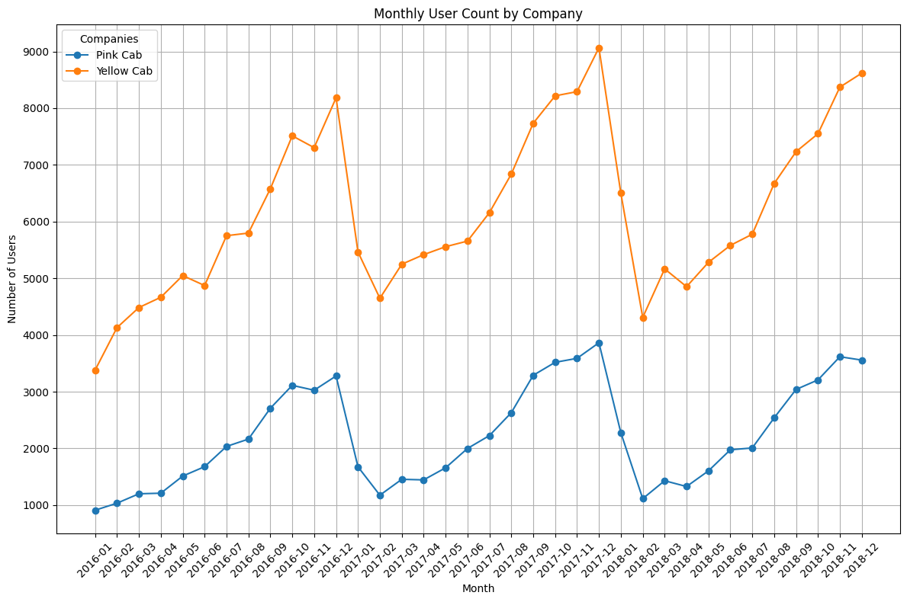
Monthly user analysis of the companies
Yellow Cab consistently outperforms Pink Cab in user numbers, with both showing overall growth from 2016 to 2018. Both companies experience seasonal dips, particularly at the start of each year, followed by recovery. Yellow Cab sees stronger growth and higher peaks, while Pink Cab grows steadily but remains smaller.

Slide 4
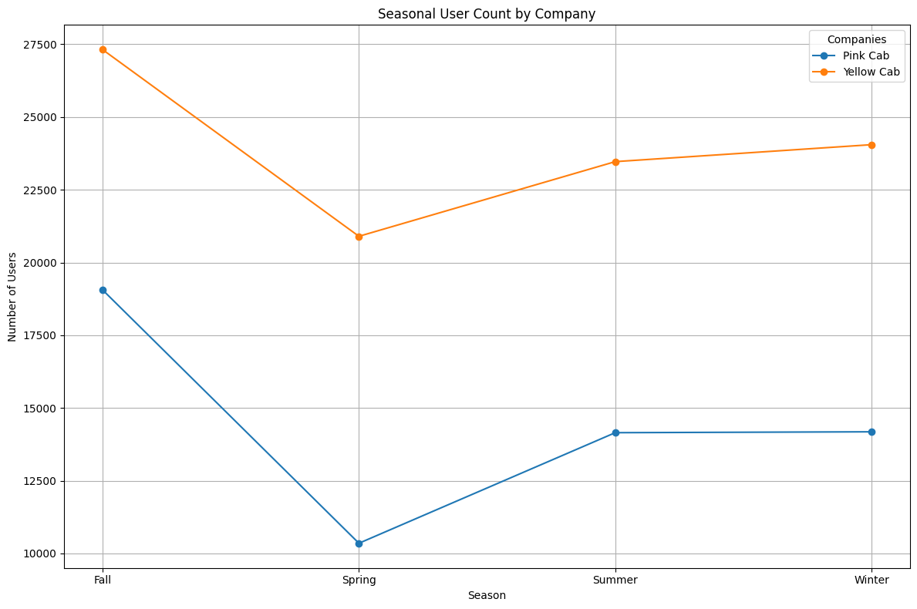
Seasonal user analysis of companies
Yellow Cab maintains steady usage across seasons, while Pink Cab experiences larger fluctuations. Fall is the peak season for both companies, with Spring showing the lowest user counts.

Slide 5
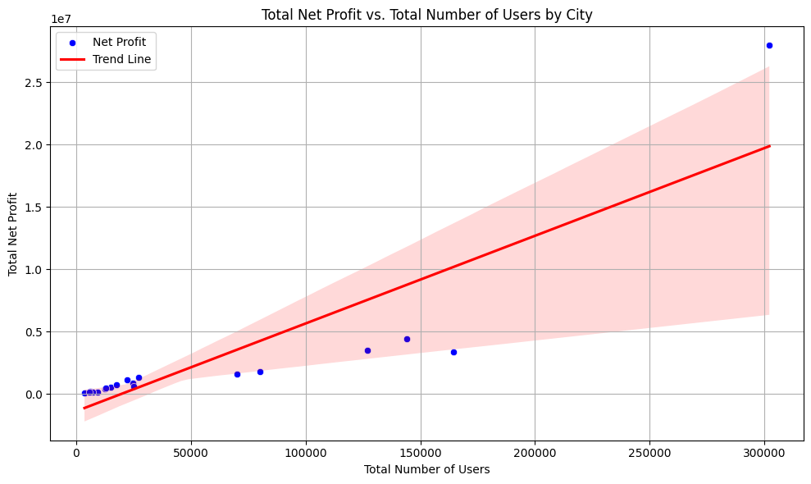
Net profit analysis by number of customers
It indicates that as the number of users increases, the net profit also increases. This suggests that an increase in the number of users positively impacts profitability.

Slide 6
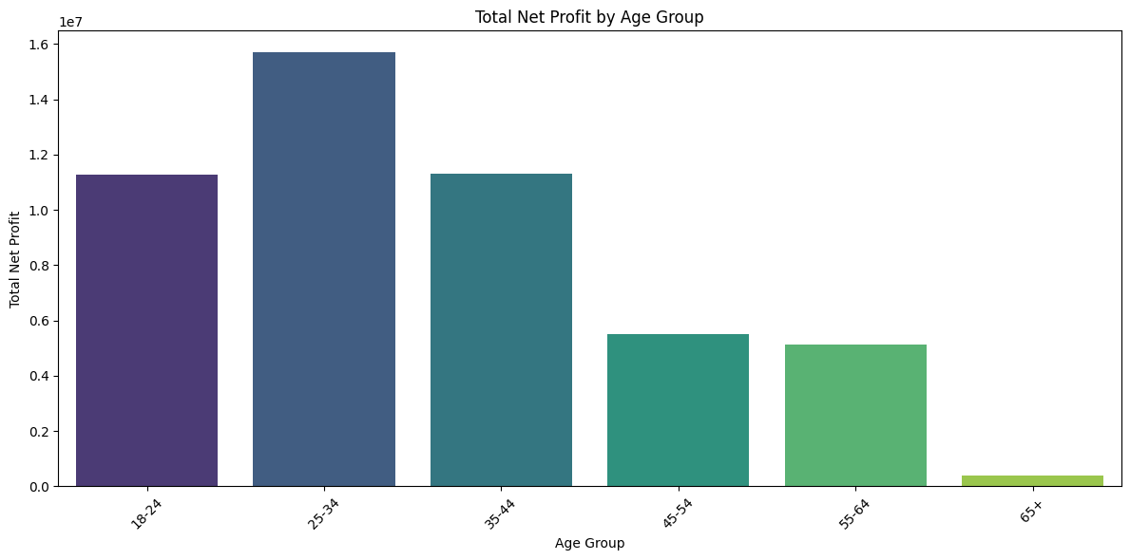
Customer segment attributes 1)Age
The age groups 18-24 and 25-34 have the highest net profits, indicating that these groups contribute the most to the total net profit. The other age groups have significantly lower net profits.

Slide 7
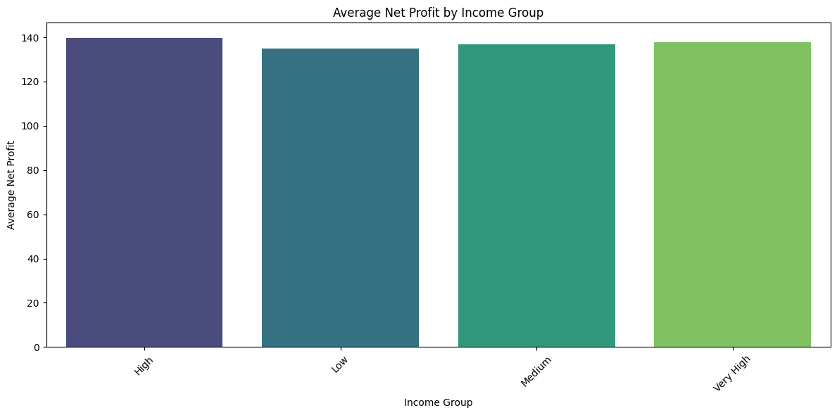
Customer segment attributes 2)Income
The ‘High’ income group has the highest average net profit, while the ‘Low’ income group has the lowest. This indicates that higher income groups contribute more to the average net profit.

Slide 8
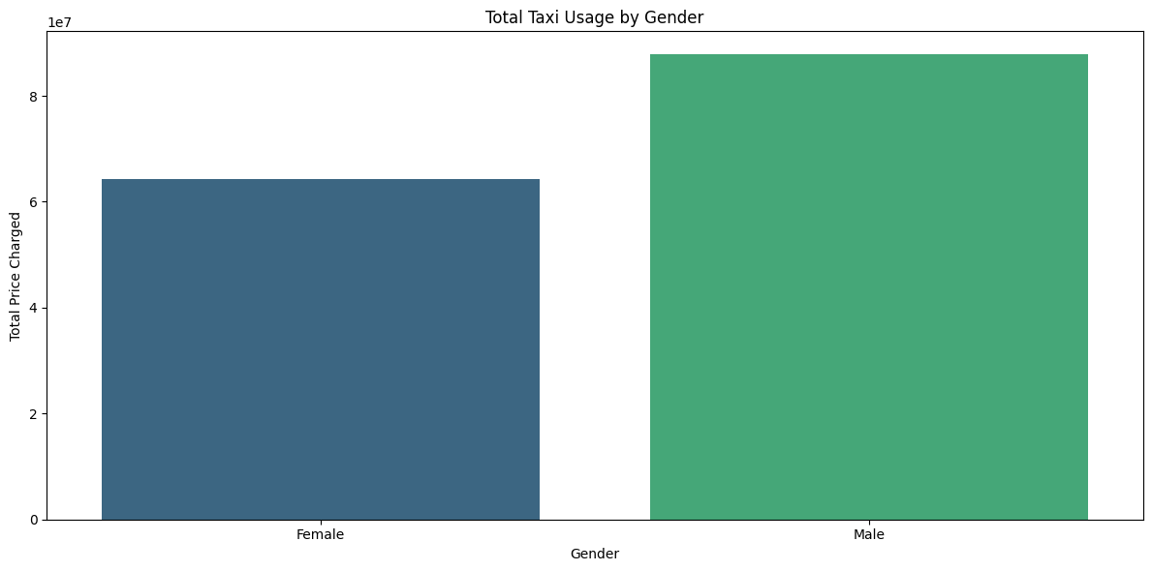
Customer segment attributes 3)Gender
The bar for males is significantly higher than the bar for females, indicating that males have a higher total taxi usage cost.

Slide 9
Yellow Cab consistently outperforms Pink Cab in terms of user numbers across different seasons and months, indicating stronger demand and customer retention.
Yellow Cab shows resilience, with relatively steady usage despite seasonal fluctuations, making it a more stable investment opportunity.
Seasonal Analysis reveals that Yellow Cab peaks in Fall and recovers well after seasonal dips, while Pink Cab sees sharper drops in user counts, especially during Spring.
Given Yellow Cab's stronger performance, consistent growth, and stability across seasons, Yellow Cab is recommended as the preferred investment opportunity for XYZ in the taxi sector.

